Slide 1
Mit adsp:Capstone Project
Used Cars Price Prediction
Cassian Raja Thomas

Slide 2

PROBLEM DEFINITION
Used Car Market in India is rapidly growing but contains substantial uncertainties in both pricing and supply.
Different factors influence the actual worth of the car making it difficult to predict its accurate price.
Sellers need accurate and fair compensation at the same time protecting the growth of the Used Car Market

Slide 3
PROBLEM TO SOLVE
Develop an effective pricing model that can predict the price of any used car
Identify the features/attributes that have the most significant role in affecting a car’s price
Can we use just Linear Regression Model or a Decision tree and a Random Forest?

Slide 4
SOLUTION APPROACH
Found that Linear Regression model has a better accuracy in predicting the value
Apply Lasso Regression Model to identify the most significant features from the dataset
Lasso selects coefficients with greater tendency

Slide 5
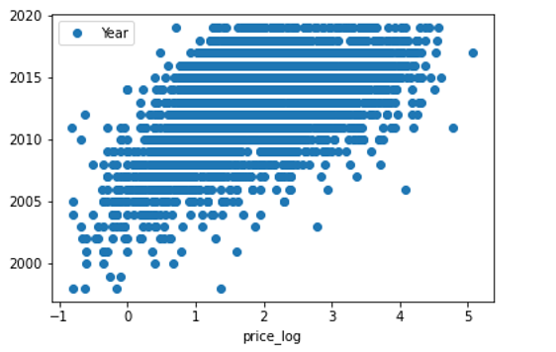
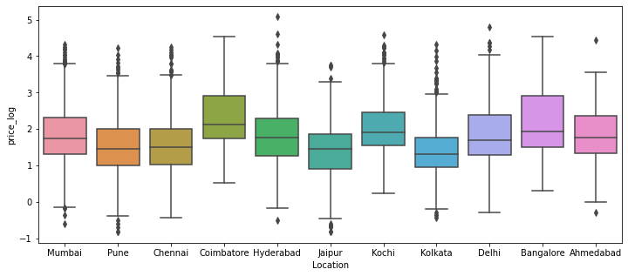
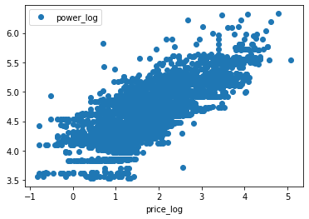
DATA ANALYSIS & ENGINEERING
Identify skewness in data and apply log transformation
Impute the missing values
Perform Univariate/Bivariate analysis and identify significant correlation between variables
Engine Power and Year had the highest correlation with price

Slide 6
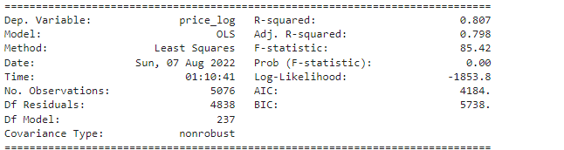
PROPOSED MODEL SOLUTION
Normalized version of price (price_log) is used for modelling the dataset.
The entire dataset of 7253 used car entries are split into train and test dataset on a 70% - 30% ratio.
Initial performance of the Linear Regression
R-square on training set : 0.7040732008196231
R-square on test set : 0.6574047216841202
RMSE on training set : 5.8527691291856705
RMSE on test set : 6.329361466562765
OLS Regression Results
Linear Regression couldn’t identify the important feature variable.
Lasso Grid search best estimator identified ‘Power’ and ‘Year as the important features

Slide 7
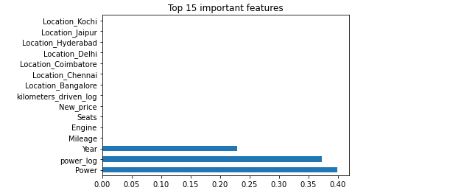
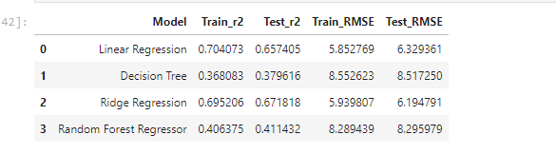
PERFORMANCE OF REGRESSION MODELS
Decision Tree and Random forest regressor performed weaker
RMSE values for Ridge Regressor were slightly higher than Linear Regression
Overall, the Engine Power and Year was identified as important features by Decision Tree, Random Forest regressor and Ridge/Lasso Regressors.

Slide 8
BUSINESS RECOMMENDATIONS
More the power of the engine, the car is priced higher. More the car is recently made, it’s priced expensive and it’s from the first hand owner.
Cities with more cosmopolitan population and cities with higher growth of IT and other technological job sectors have more demand for cars. More first-hand owners tend to switch to a new car with modern features.
Identify more used vehicles which are manufactured after 2017 and increase their supply and sales.
Introduce more campaigns in developing cities like Bangalore, Coimbatore.
Shift the focus on vehicles with more engine power that attract the current generation of customers.
Promote sales of single hand (first owner) vehicles. Introduce more deals & discounts to boost their sales.

Slide 9




Thank you

